Slide 1


Slide 2

add, subtract, and multiply matrices, and
apply rules of binary operations on matrices.

Slide 3


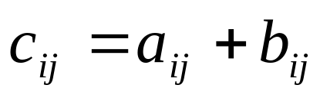
Two matrices and can be added only if they are the same size. The addition is then shown as
where

Slide 4

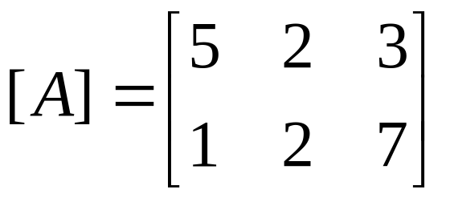
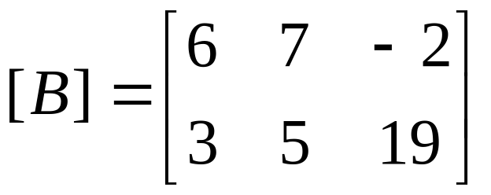
Add the following two matrices.
.

Slide 5


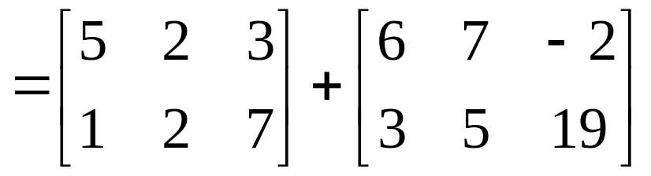
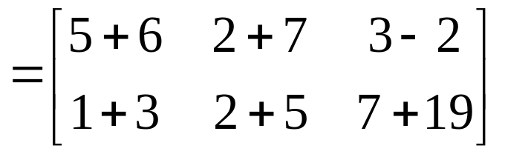
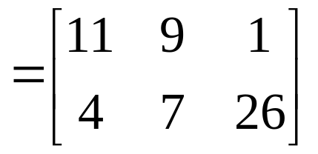

Slide 6

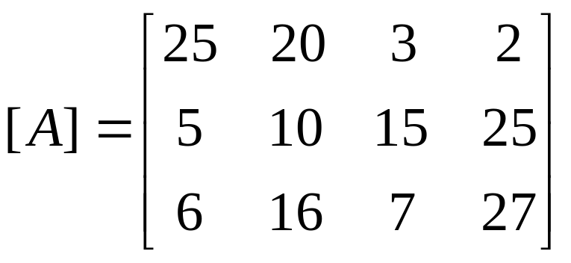
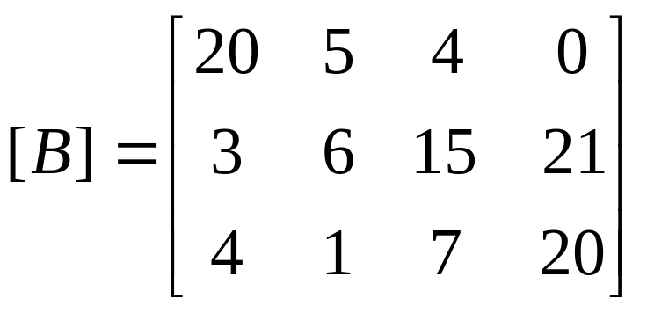
Blowout r’us store has two store locations and , and their sales of tires are given by make (in rows) and quarters (in columns) as shown below.
where the rows represent the sale of Tirestone, Michigan and Copper tires respectively and the columns represent the quarter number: 1, 2, 3 and 4. What are the total tire sales for the two locations by make and quarter?

Slide 7



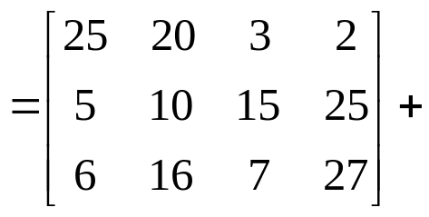
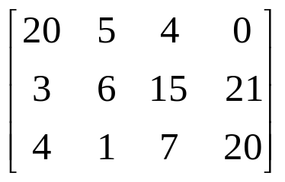
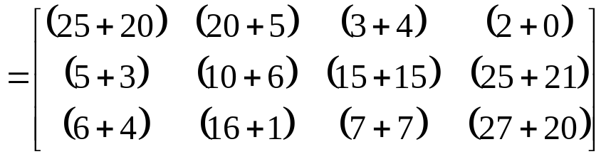

Slide 8
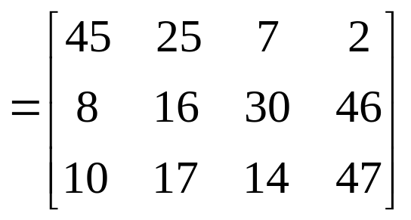

The answer then is,
So if one wants to know the total number of Copper tires sold in quarter 4 at the two locations, we would look at Row 3 – Column 4 to give

Slide 9




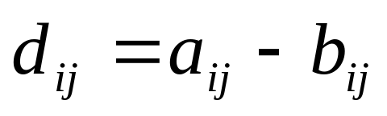
can be subtracted only if they are the same size. The subtraction is then given by
Two matrices
and
Where

Slide 10


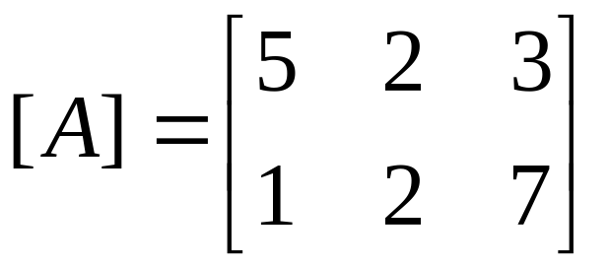

Subtract matrix
from matrix .

Slide 11

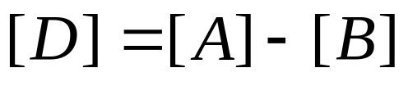
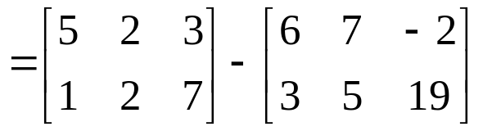
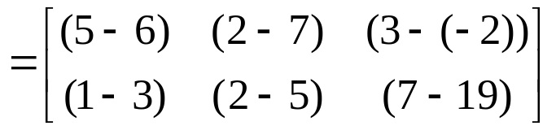
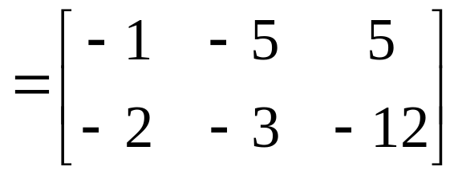

Slide 12

Blowout r’us store has two store locations and , and their sales of tires are given by make (in rows) and quarters (in columns) as shown below.
where the rows represent the sale of Tirestone, Michigan and Copper tires respectively and the columns represent the quarter number: 1, 2, 3 and 4. What are the total tire sales for the two locations by make and quarter?

Slide 13


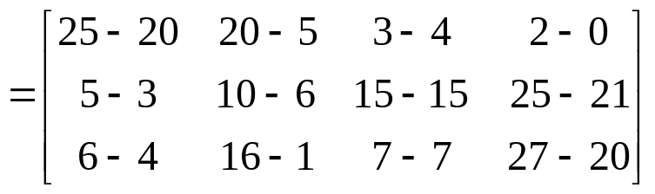

Slide 14
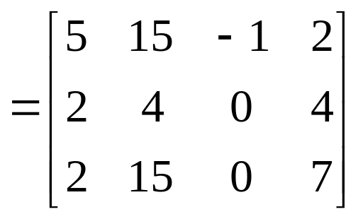


The answer then is,
So if you want to know how many more Copper tires were sold in quarter 4 in store A than store B, . Note that implies that store A sold 1 less in Michigan tire than store B in quarter 3.

Slide 15

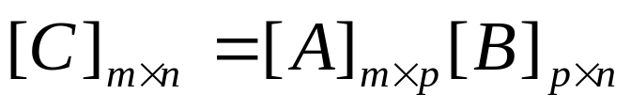




Two matrices [A] and [B] can be multiplied only if the number of columns of [A] is equal to the number of rows of [B] to give
If
is a
matrix and
is a
matrix, the resulting matrix
is a
matrix.

Slide 16
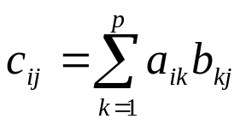






So how does one calculate the elements of
matrix?
for each
and
To put it in simpler terms, the
row and
column of the
matrix in
is calculated by multiplying the
row of
by the
column of .

Slide 17

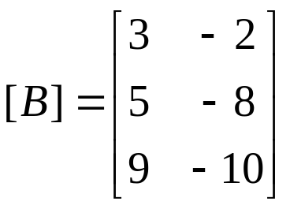
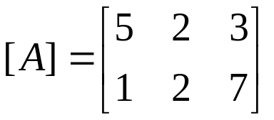

Given the following two matrices,
Find their product,

Slide 18



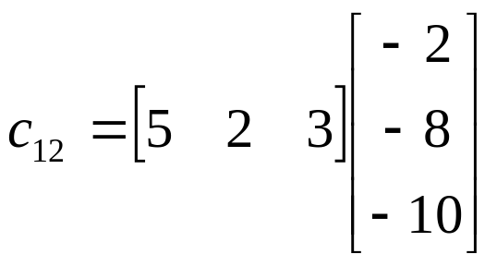


be found by multiplying the first row of
by the second column of ,

Slide 19
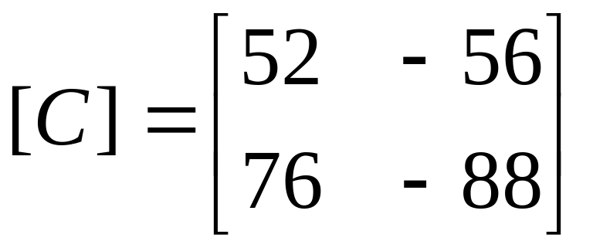
to give
Similarly, one can find the other elements of

Slide 20

Blowout r’us store has two store locations and , and their sales of tires are given by make (in rows) and quarters (in columns) as shown below.
where the rows represent the sale of Tirestone, Michigan and Copper tires respectively and the columns represent the quarter number: 1, 2, 3 and 4.

Slide 21




. The price matrix is
Find the per quarter sales of store
if the following are the prices of each tire.
Tirestone = $33.25
Michigan = $40.19
Copper = $25.03
The answer is given by multiplying the price matrix by the quantity of sales of store
. The price matrix is .

Slide 22



dollars is given by the four columns of the row vector
Therefore, the per quarter sales of store
Remember since we are multiplying a 1
3 matrix by a 3
4 matrix, the
resulting matrix is a 1 4 matrix.

Slide 23




If
is a
matrix and
is a real number, then the scalar product of
and
is another
matrix , where .

Slide 24

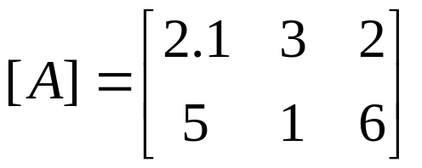

Given the matrix,
Find

Slide 25

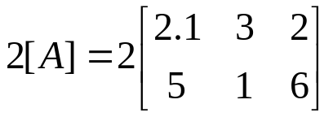
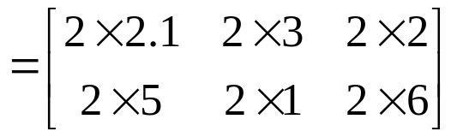
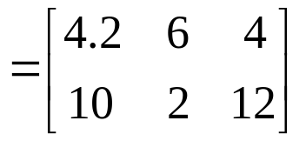
The solution to the product of a scalar and a matrix by the following method,

Slide 26





If
are matrices of the same size and are scalars,
then
is called a linear combination of

Slide 27

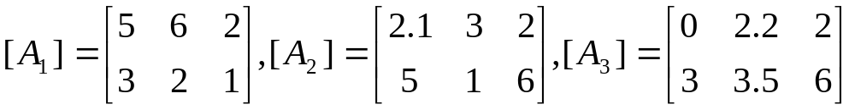
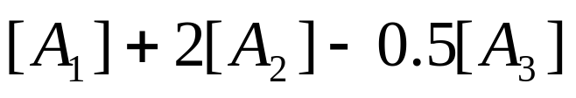
If
then find

Slide 28

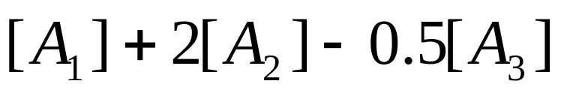
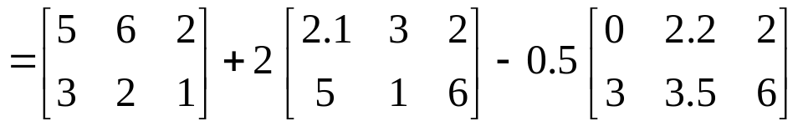
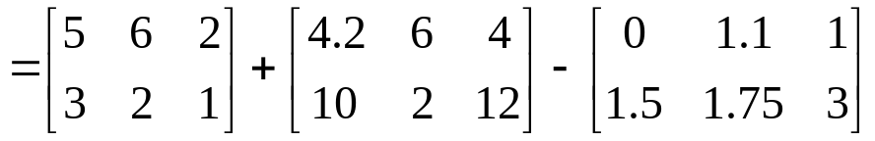
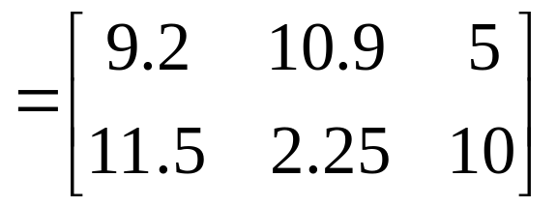

Slide 29

Commutative law of addition
If [A] and [B] are m×n matrices, then
[A]+[B]=[B]+[A]
Associative law of addition
If [A], [B] and [C] are m×n, n×p, and p×r size matrices, respectively, then
[A]+([B]+[C])=([A] +[B])+[C]
Associative law of multiplication
If [A], [B] and [C] are all m×n, n×p and p×r size matrices, respectively, then
[A]([B][C])=([A][B])[C]
and the resulting matrix size on both sides of the equation is m×r.

Slide 30
Distributive Law
If [A] and [B] are m×n matrices, and [C] and [D] are n×p size matrices
[A]([C]+[D])=[A][C]+[A][D]
([A]+[B])[C]=[A][C]+[B][C]
and the resulting matrix size on both sides of the equation is m×r.

Slide 31

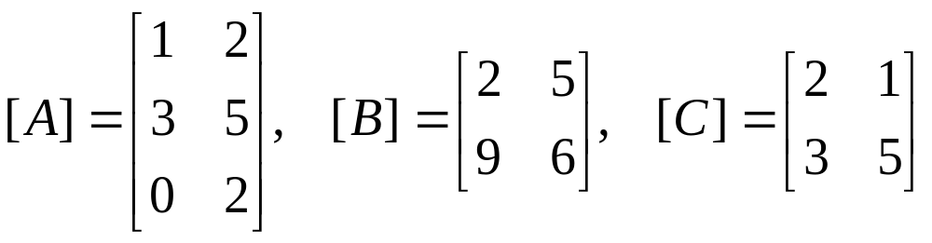
Illustrate the associative law of multiplication of matrices using

Slide 32


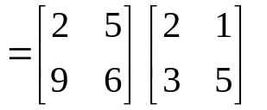
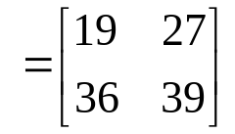
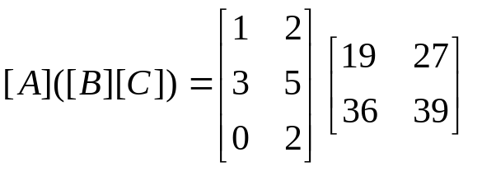
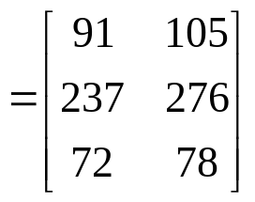

Slide 33
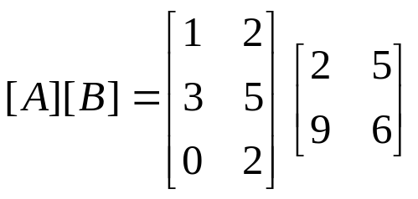
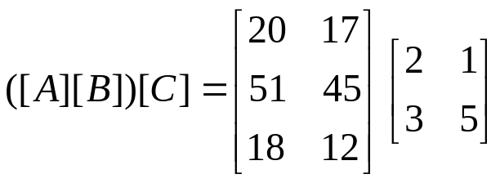
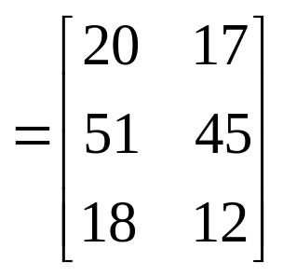
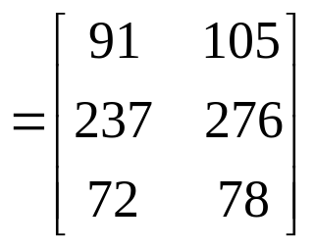

Slide 34

If [A][B] exists, number of columns of [A] has to be same as the number of rows of [B] and if [B][A] exists, number of columns of [B] has to be same as the number of rows of [A].
Now for [A][B]=[B][A], the resulting matrix from [A][B] and [B][A] has to be of the same size. This is only possible if [A] and [B] are square and are of the same size. Even then in general [A][B]≠[B][A].

Slide 35

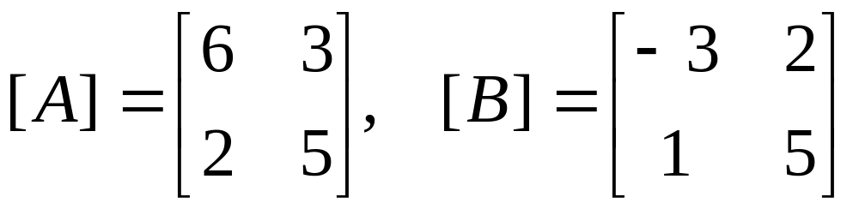
Determine if
[A][B]=[B][A]
for the following matrices

Slide 36

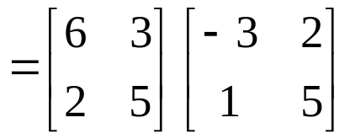
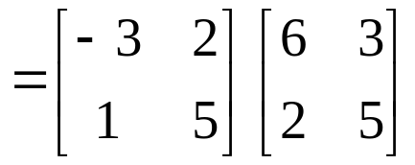


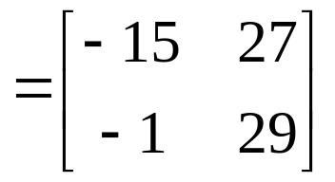
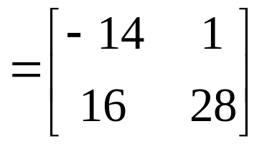

Therefore

